Slide 1
DEVELOPMENT OF MUSCLE
Ngwazi DR K.O. AWORI
Dept. of Human Anatomy.

Slide 2
INTRODUCTION
From epiblast
After gastrulation, the vast majority take up temporary positions in the paraxial mesoderm.
.

Slide 3
INTRODUCTION
The embryonic cells that give rise
to muscle are myoblasts.
Most skeletal muscles develop
before birth.

Slide 4
OBJECTIVES
Origin of skeletal, cardiac & smooth muscles & myoepithelial cells.
Parts & derivatives of a myotome plate
Histogenesis of various muscle types
Factors in muscle location & morphology
Growth of muscle
Congenital defects

Slide 5
SOURCES OF MESENCHYME
Skeletal muscle is from the paraxial
mesoderm
Iridal & ciliary muscles of the eye are
neuroectodermal
.

Slide 6
SOURCES OF MESENCHYME
Cardiac smooth muscle of the GIT from splanchnic mesoderm
Smooth muscles of blood vessels & erector pili muscles from local mesenchyme
Myoepithelial cells from ectoderm

Slide 7
PARAXIAL MESODERM
1-7 remain as somitomeres
8th pair caudally form somites

Slide 8
ORIGIN OF REGIONAL SKELETAL MUSCULATURE
Cranial musculature mainly from somitomeres.
Patterns directed by connective tissue elements.
Muscles of the tongue develop from occipital myotomes.

Slide 9
ORIGIN OF REGIONAL SKELETAL MUSCULATURE
Trunk muscles arise from somites.
Limb muscles are from somitic mesoderm, cells which migrate to the developing limb bud.

Slide 10
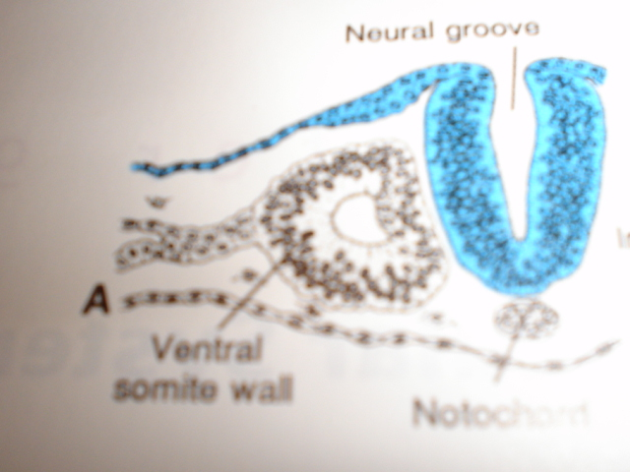
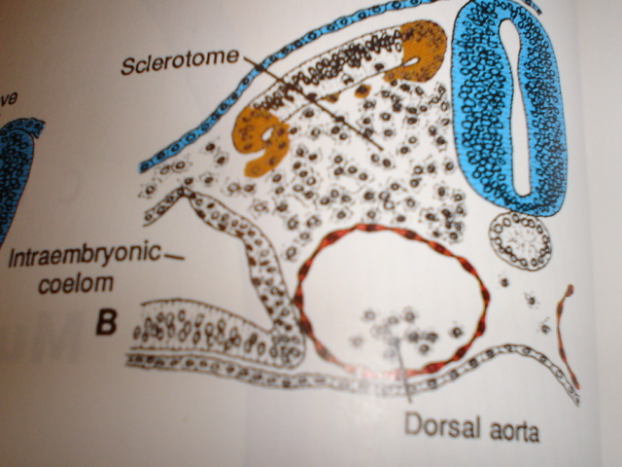
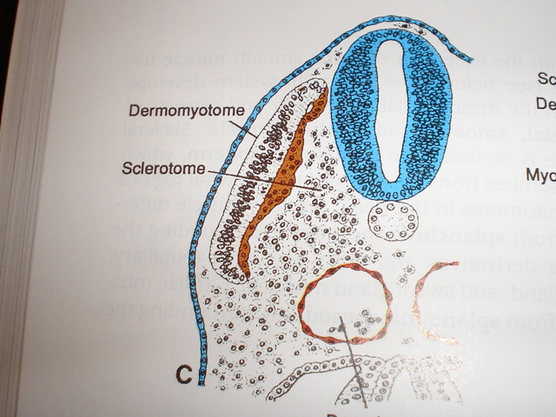
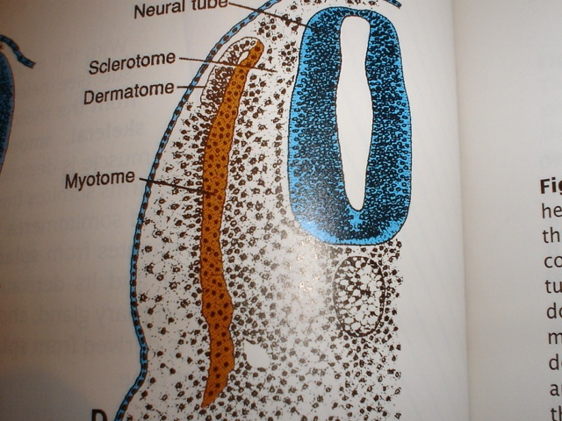
STAGES IN THE DEVELOPMENT OF A SOMITE
1
2
3
4

Slide 11
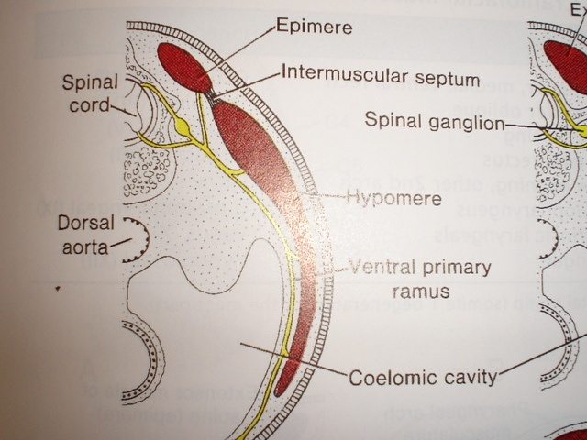
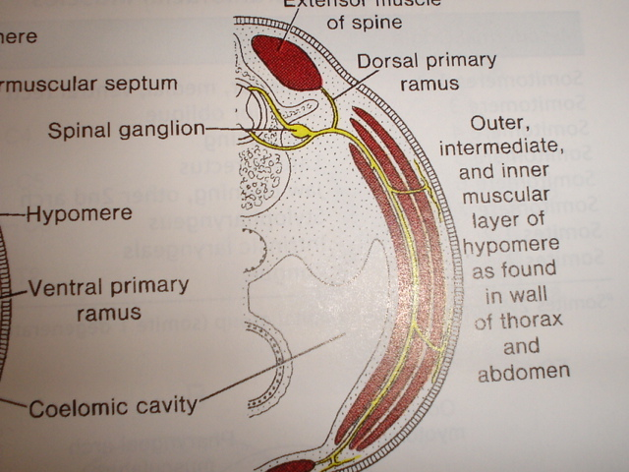
PARTS AND DERIVATIVES OF A MYOTOME
1
2

Slide 12
DERIVATIVES OF THE MYOTOME
EPIMERE
Extensor muscles of the neck.
Erector spinae of the back.
Lumbar extensor muscles.
Sacral and coccygeal myotomes degenerate to form dorsal sacrococcygeal ligaments.

Slide 13
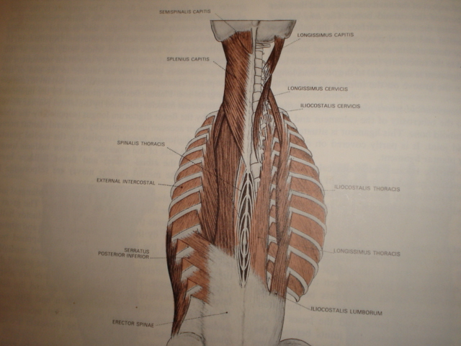
EPIMERE

Slide 14
DERIVATIVES OF THE MYOTOME
Hypomere
In the neck:
prevertebral & scalene muscles
geniohyoid & infrahyoid muscles( from ventral tip of hypomere).

Slide 15
DERIVATIVES OF THE MYOTOME
Hypomere
In the thorax: intercostal muscles.
In the abdomen: the oblique muscles & rectus abdominis (from ventral tip) and quadratus lumborum

Slide 16
DERIVATIVES OF THE MYOTOME
Hypomere
Sacrococcygeal region
Pelvic diaphragm
Perianal muscles

Slide 17
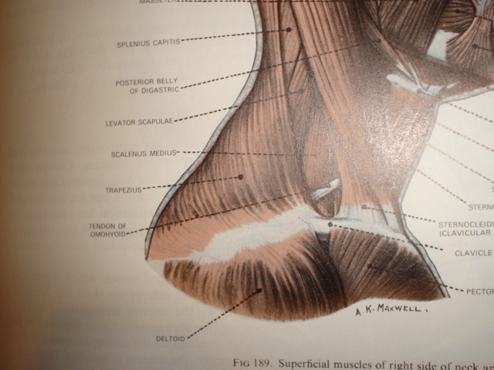
HYPOMERE

Slide 18
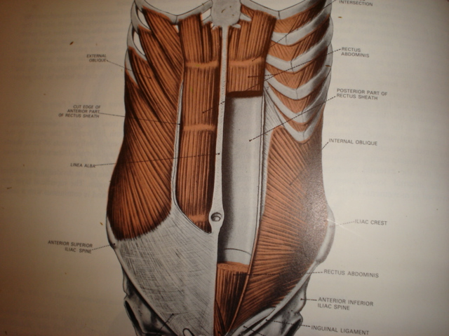
HYPOMERE

Slide 19
HISTOGENESIS OF MUSCULAR TISSUE
Skeletal muscle
Migration of mesenchymal cells.
Mesenchymal differentiate into myoblasts.
Fusion of myoblasts to form myotubes.
Development of myofilaments in the cytoplasm of the myotubes
Transformation of myotubes into myocytes
Investment of myocytes by connective tissue

Slide 20
HISTOGENESIS OF MUSCULAR TISSUE
Cardiac muscle
Mesenchymal cells are of splanchnic origin.
Myoblasts establish intercalated disks between them.
Some cardiac myocytes undergo an alternative pathway of differentiation to form the conduction system

Slide 21
FACTORS IN MUSCLE LOCATION, ORGANISATION AND MORPHOGENESIS.
MIGRATION
Muscles of facial expression from the neck
Trapezius from the head to neck & back
Latismus dorsi from the cervical region to the back.

Slide 22
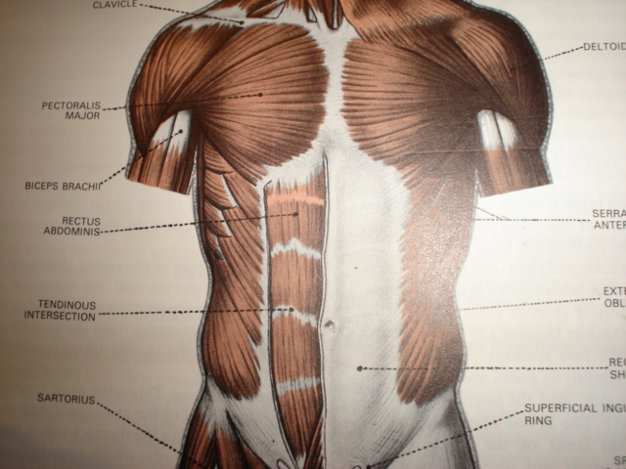
FACTORS IN MUSCLE LOCATION, ORGANISATION AND MORPHOGENESIS.
FUSION
Rectus abdominis from
fusion of mesenchymal
bars at the ventral tips of
the abdominal
hypomere.
RECTUS ABD

Slide 23
FACTORS IN MUSCLE LOCATION, ORGANISATION AND MORPHOGENESIS
SPLITTING
Intercostal muscles
Oblique abdominal muscles

Slide 24
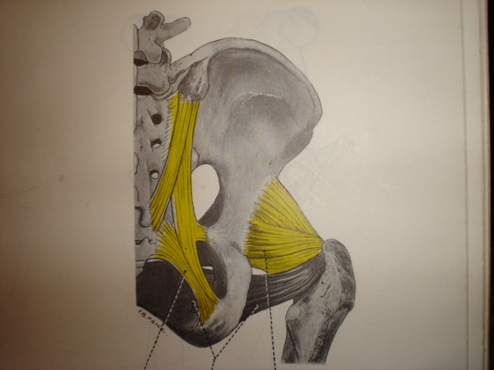
FACTORS IN MUSCLE LOCATION, ORGANISATION AND MORPHOGENESIS
IV. REGRESSION
Some myotomes
regress into aponeurosis
and ligaments e.g
abdominal aponeurosis,
the sacrospinous and
sacrotuberous
ligaments.
Sacrotuberous
ligament
Sacrospinous
ligament

Slide 25
FACTORS IN MUSCLE LOCATION, ORGANISATION AND MORPHOGENESIS
V. INTERACTION WITH NERVES
Muscle fibres which do not form functional units with nerves degenerate.
VI. INFORMATION IN THE MESENCHYME

Slide 26
MOLECULAR REGULATION OF MUSCLE DEVELOPMENT
Myogenic regulatory factors regulate transcription.
They include, myogenic determining factor 1 (MyoD), myogenin, myf 5 and MRF 4.

Slide 27
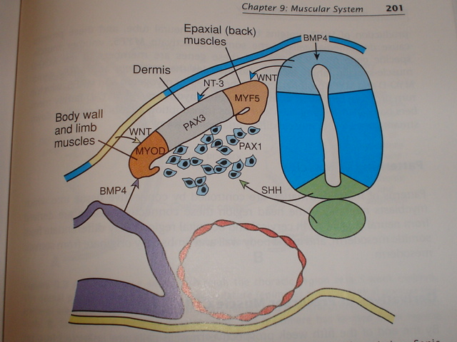
MOLECULAR REGULATION OF MUSCLE DEVELOPMENT

Slide 28
GROWTH OF MUSCLE
MECHANISMS
Hypertrophy
2) Hyperplasia e.g. Uterus in pregnancy
3) In skeletal muscle, some undifferentiated cells called myosatellite cells may contribute to growth by forming new myoblasts

Slide 29
GROWTH OF MUSCLE
FACTORS INFLUENCING:
Nutrition
Innervation
Exercise
Hormones: anabolic steroids e.g testosterone lead to muscle growth, others include growth hormone

Slide 30
CONGENITAL MALFORMATIONS absence
palmaris longus, plantaris, pectoralis major etc.
Absence of some muscles may cause
immobility of multiple joints
(ARTHROGRYPOSIS MULTIPLEX CONGENITA).

Slide 31
Absence of pectoralis major may be associated with breast defects & limb malformations
Absent pect major + syndactyly (POLAND SYNDROME).

Slide 32
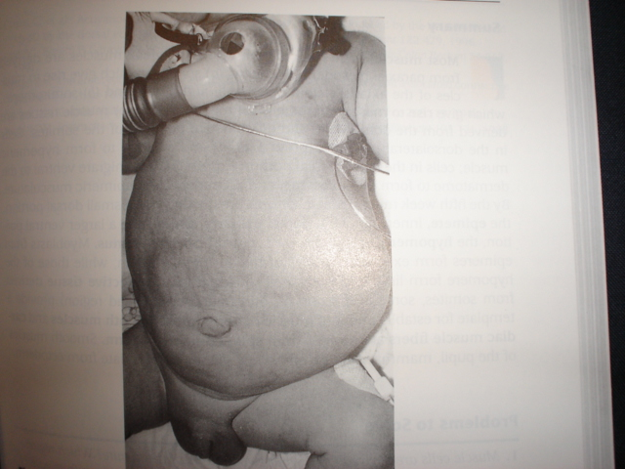
CONGENITAL MALFORMATIONS
2. CONGENITAL HYPOTONIA
e.g PRUNE BELLY SYNDROME

Slide 33
CONGENITAL MALFORMATIONS
Fibrosis
e.g congenital torticollis (wry neck)
A muscle undergoes fibrosis due to
vascular failure, in this case,
sternoceidomastoid.

Slide 34
CONGENITAL MALFORMATIONS
4. CONGENITAL FAMILIAL WEAKNESS
e.g congenital ptosis.

